Slide 1






NWSCC Dual Registration

Slide 2




Dual Enrollment
Completing your Registration for Summer 2025 or Fall 2025 is very easy. Follow these steps to get registered today.
Don’t forget that summer classes are in session from May 27 - August 5!
If you have questions, please contact your school counselor!
Cherokee: Mrs. Leah Lockett 256-248-9050 or llockett@colbertk12.org
Colbert County: Mrs. Colbert 256-446-8214 or kcolbert@colbertk12.org
Colbert Heights: Mrs. Jackson 256-383-7875 or djackson@colbertk12.org

Slide 3
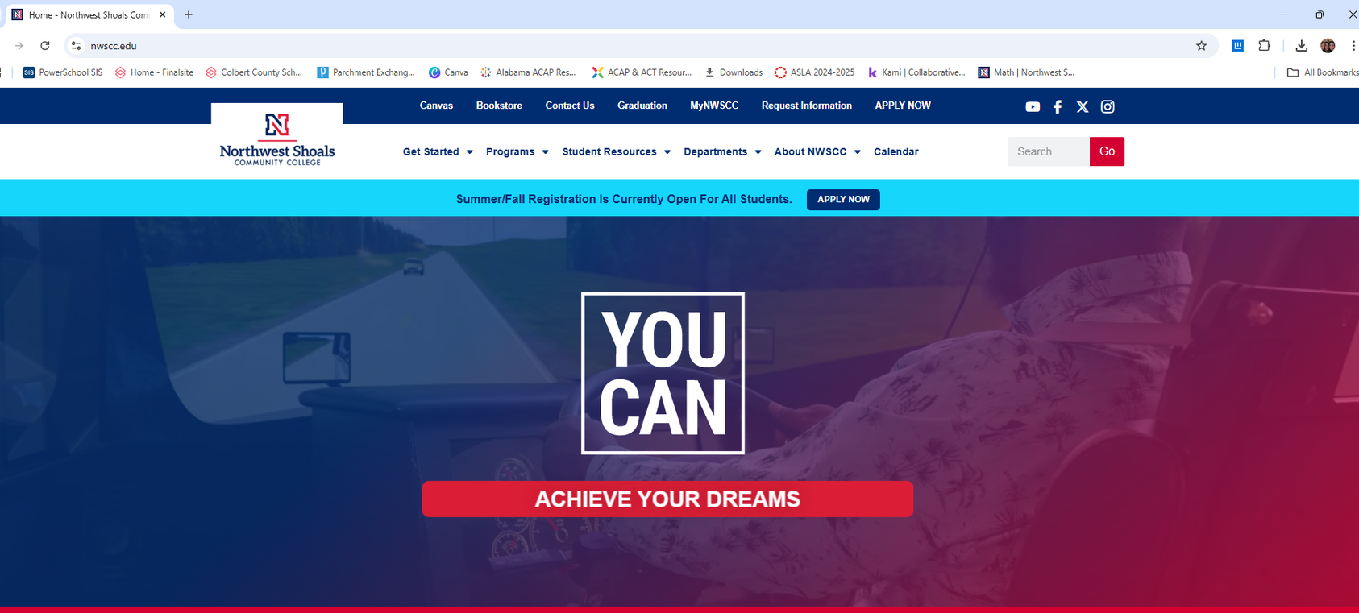

Registration Steps
Go to www.nwscc.edu and click on the APPLY NOW
link at the top of the page
Click Here!

Slide 4
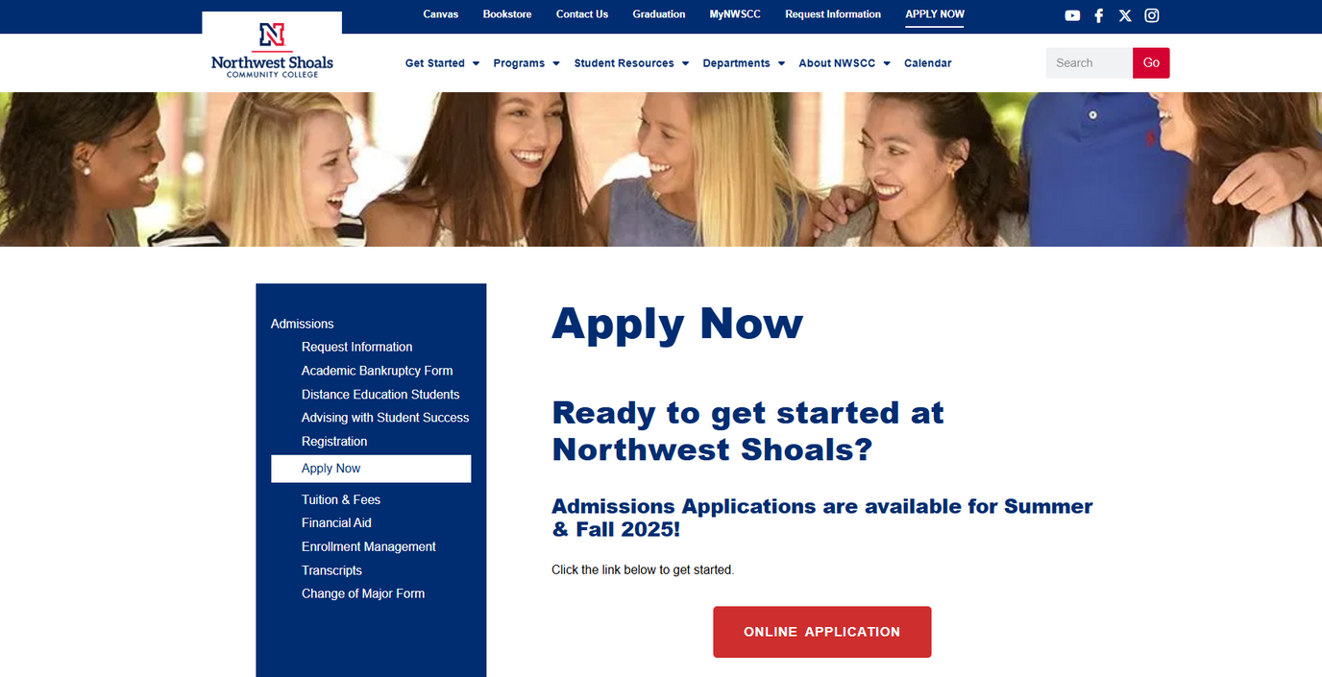
Registration Steps
2. Scroll down just a bit and click the RED Online Application Button.
Click Here!

Slide 5
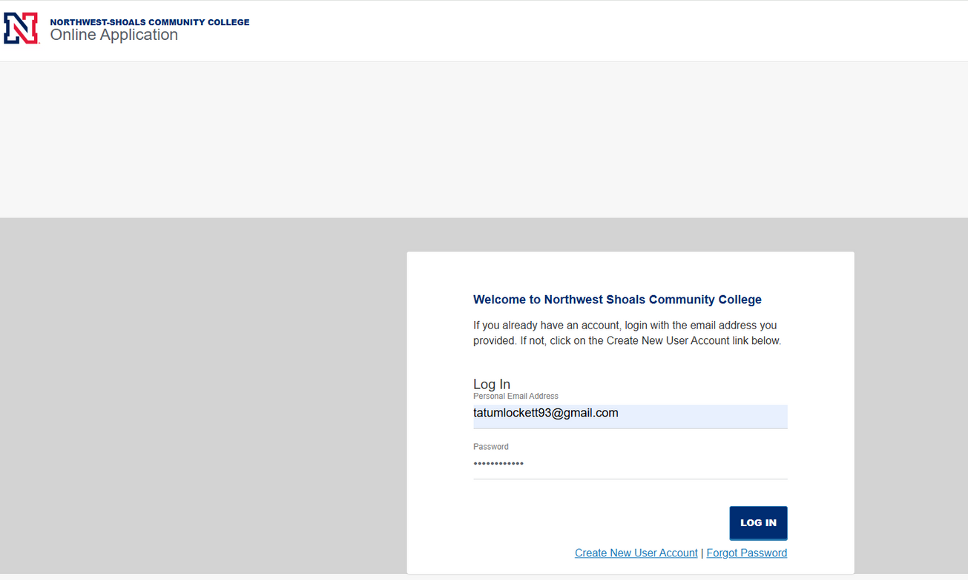
Registration Steps
3. Sign in using your personal email and the password you created when you applied to NWSCC. If you forgot your password, click the forgot password link. If you are having trouble with this step, please reach out to NWSCC!

Slide 6
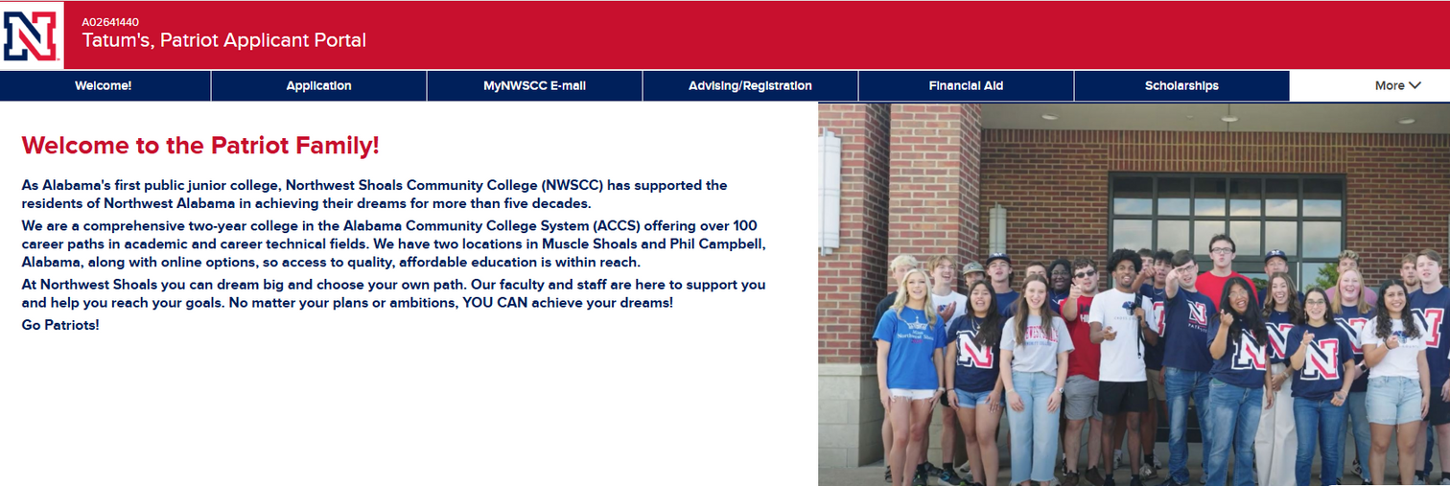
Registration Steps
4. Once you are logged in, select the Advising/Registration Tab.
Click Here!

Slide 7
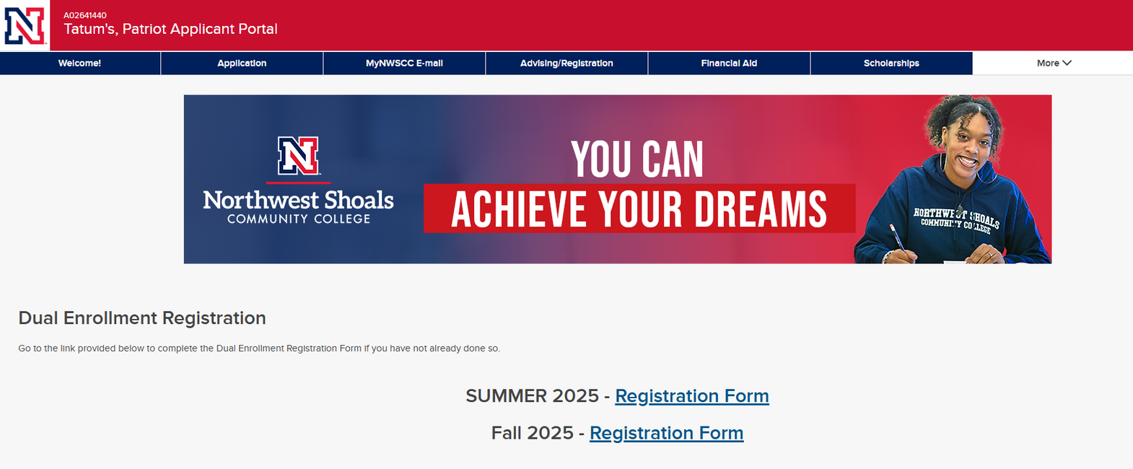
Registration Steps
4. Once you are on the Advising/Registration Tab, Select the term you are registering for, Summer or Fall, to navigate to the Registration Form you need.
Choose your term!

Slide 8
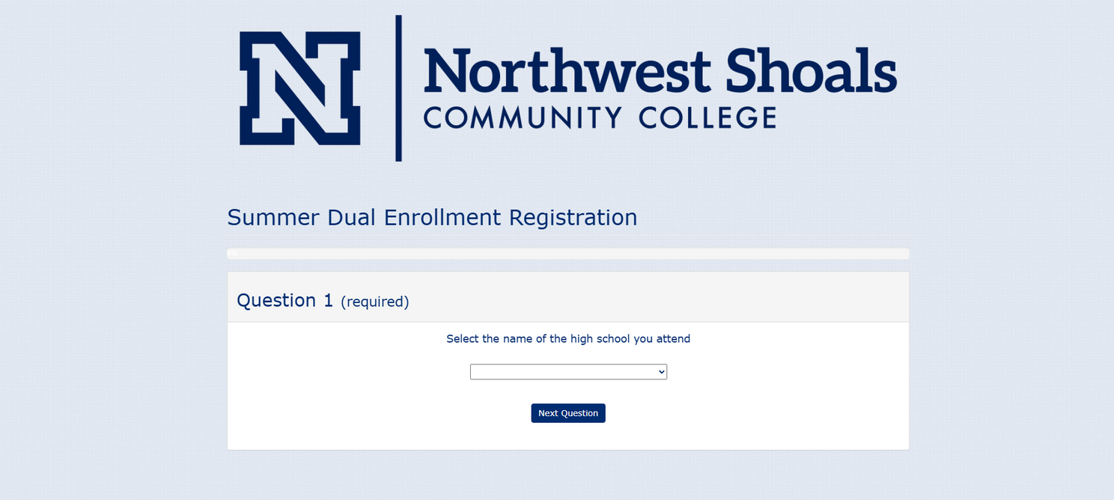
Registration Steps
5. Fill out the Summer or Fall Dual Enrollment Form. Choose from the classes recommended by Shoals or select Other and typre in the name of the class you want to take. Make sure you answer all questions, but you should leave question 18 blank. That is for NWSCC Office use only.

Slide 9
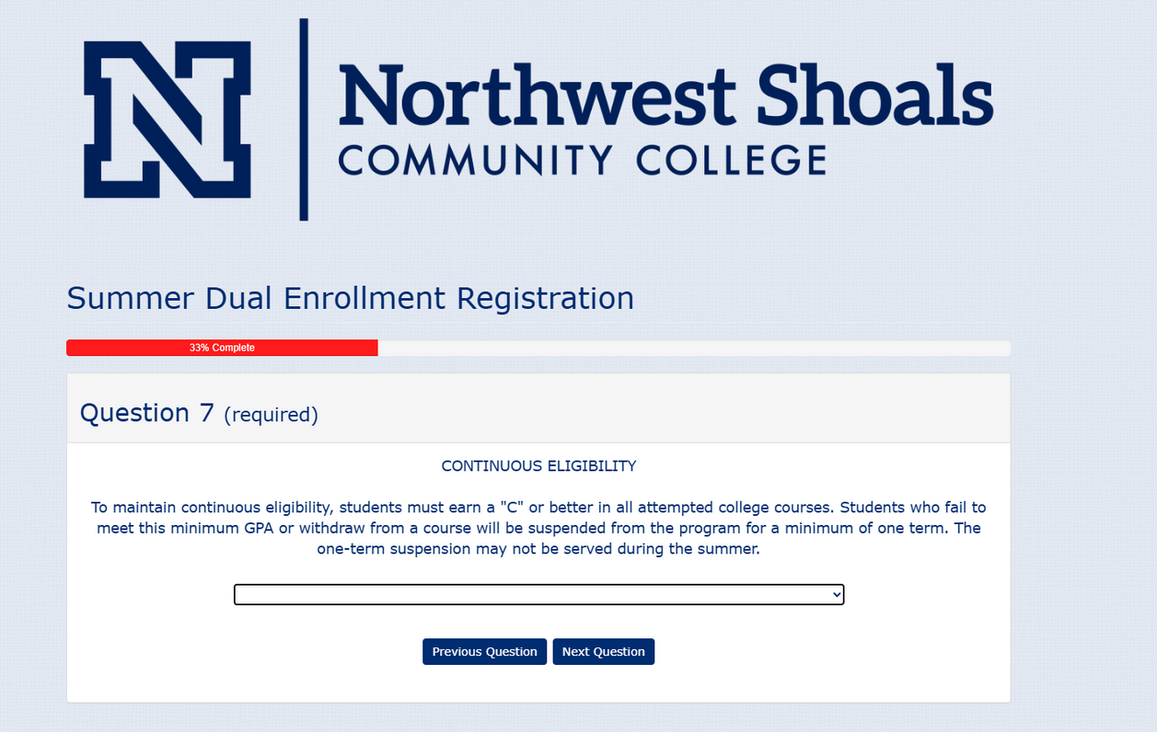
Registration Steps
6. Pay close attention to the Continuous Eligibility Policy. Failure to make a 70 or above in a Dual Enrollment course will result in suspension from the Dual Enrollment program for one semester.

Slide 10
Registration Steps
7. Submit your Registration and you are done!

Slide 11


If you have questions, reach out
to your counselor!

